Slide 1
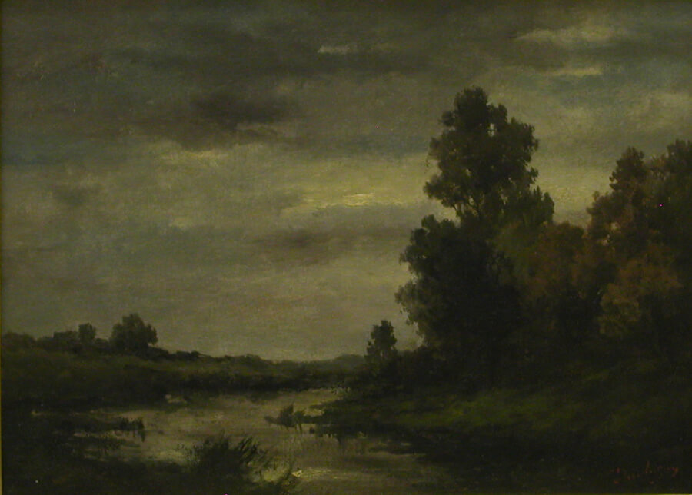
Realism
(1848-1900)

Slide 2
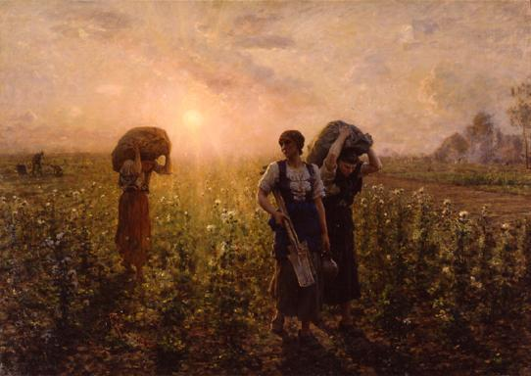
What is Realism?
Approach to art which subjects are now idealized
Does not follow rules of formal artistic theory
Tends to depict everyday characters and situations
Very “true to life” manner
Began in France in 1848
Post the French Revolution, with works relating to democracy

Slide 3
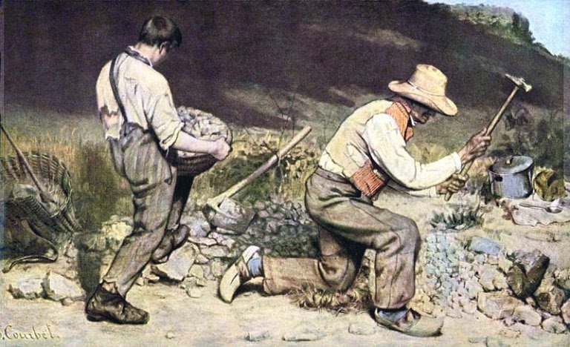
The Stone Breakers (1849)
Creator: Gustave Courbet
Medium: Oil on canvas
What’s it about: Depicts the labor unrest of 1848 in France. People wanted better wages and working conditions as consolation for their hard work. This shows two workers that cannot advance in life due to the lack of social mobility

Slide 4
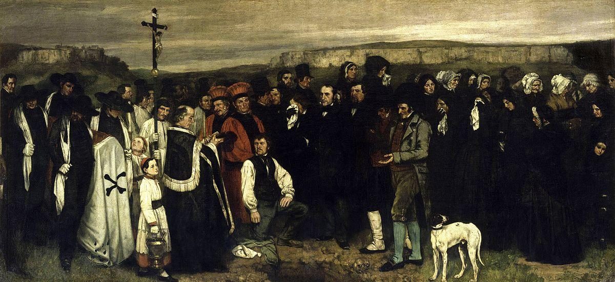
A Burial of Ornans (1849)
Creator: Gustave Courbet
Where: Musée d'Orsay, Paris, France
Medium: Oil on canvas
What’s It About: Depicts a middle-class family at a gravesite
Interesting Fact: 22-feet long

Slide 5
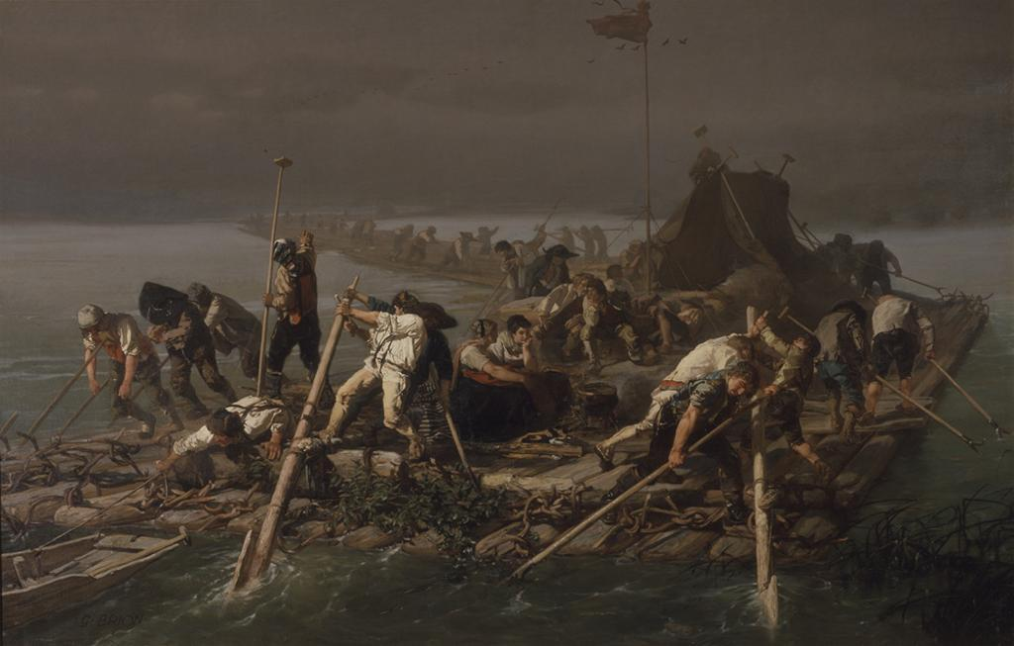
Wood Rafts on the Rhine (1855)
Creator: Gustave Brion
Where: France
Medium: Oil on canvas
What’s it about: Interpretation of Rafts of Medusa by Théodore Géricault with more naturalness and grittiness. Brion lived in Strasbourg on the Rhine.

Slide 6
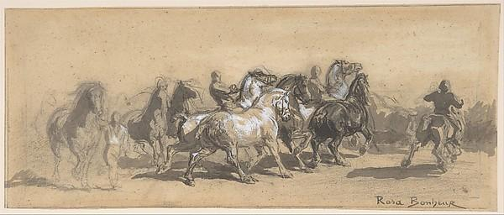
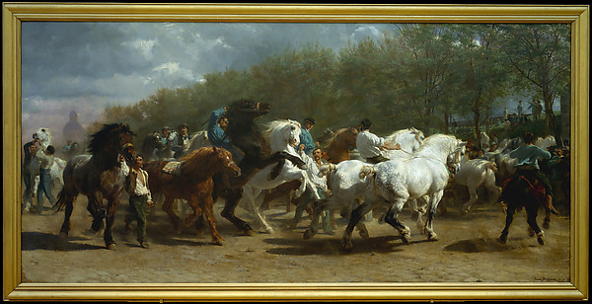
The Horse Fair (1852-1855)
Creator: Marie Rosa Bonheur
Where: Debuted at the Paris Salon in 1853 (sketch)
Medium: Oil on Canvas
What’s it About: She would go a location for a year and a half dressed as a man to discourage any attention. Depicts a scene of a horse market that would happen regularly

Slide 7
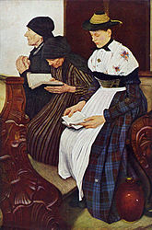
Three Women in Church (1882)
Creator: Wilhelm Leibl
Where: Created in Heilig-Kreuz-Kirche in Berbling
Medium: Oil on mahogany wood
What’s it About: Protestant Church was on the rise and he was attempting to depict the tranquility of church. Diffuse any harsh sentiments.

Slide 8
Thank you

