Slide 1
China
Karina Rangel

Slide 2
Chinese Art
Chinese art is reflected by their dynasty
Shang Dynasty
Zhou Dynasty
Han Dynasty
Tang dynasty
Many more

Slide 3
Shang(1600-1050 BCE)
and Zhou dynasty (1046-256 BCE)
This time period is known as the bronze age
Maturity of civilization and development of urbanization
Early rituals amdein bronze, rituals were important part of social function
Along the Yellow River present day Henan province emerged as the most advanced location
Zhou took over during the bronze age weapons were made designs were created , jade,Taotie

Slide 4
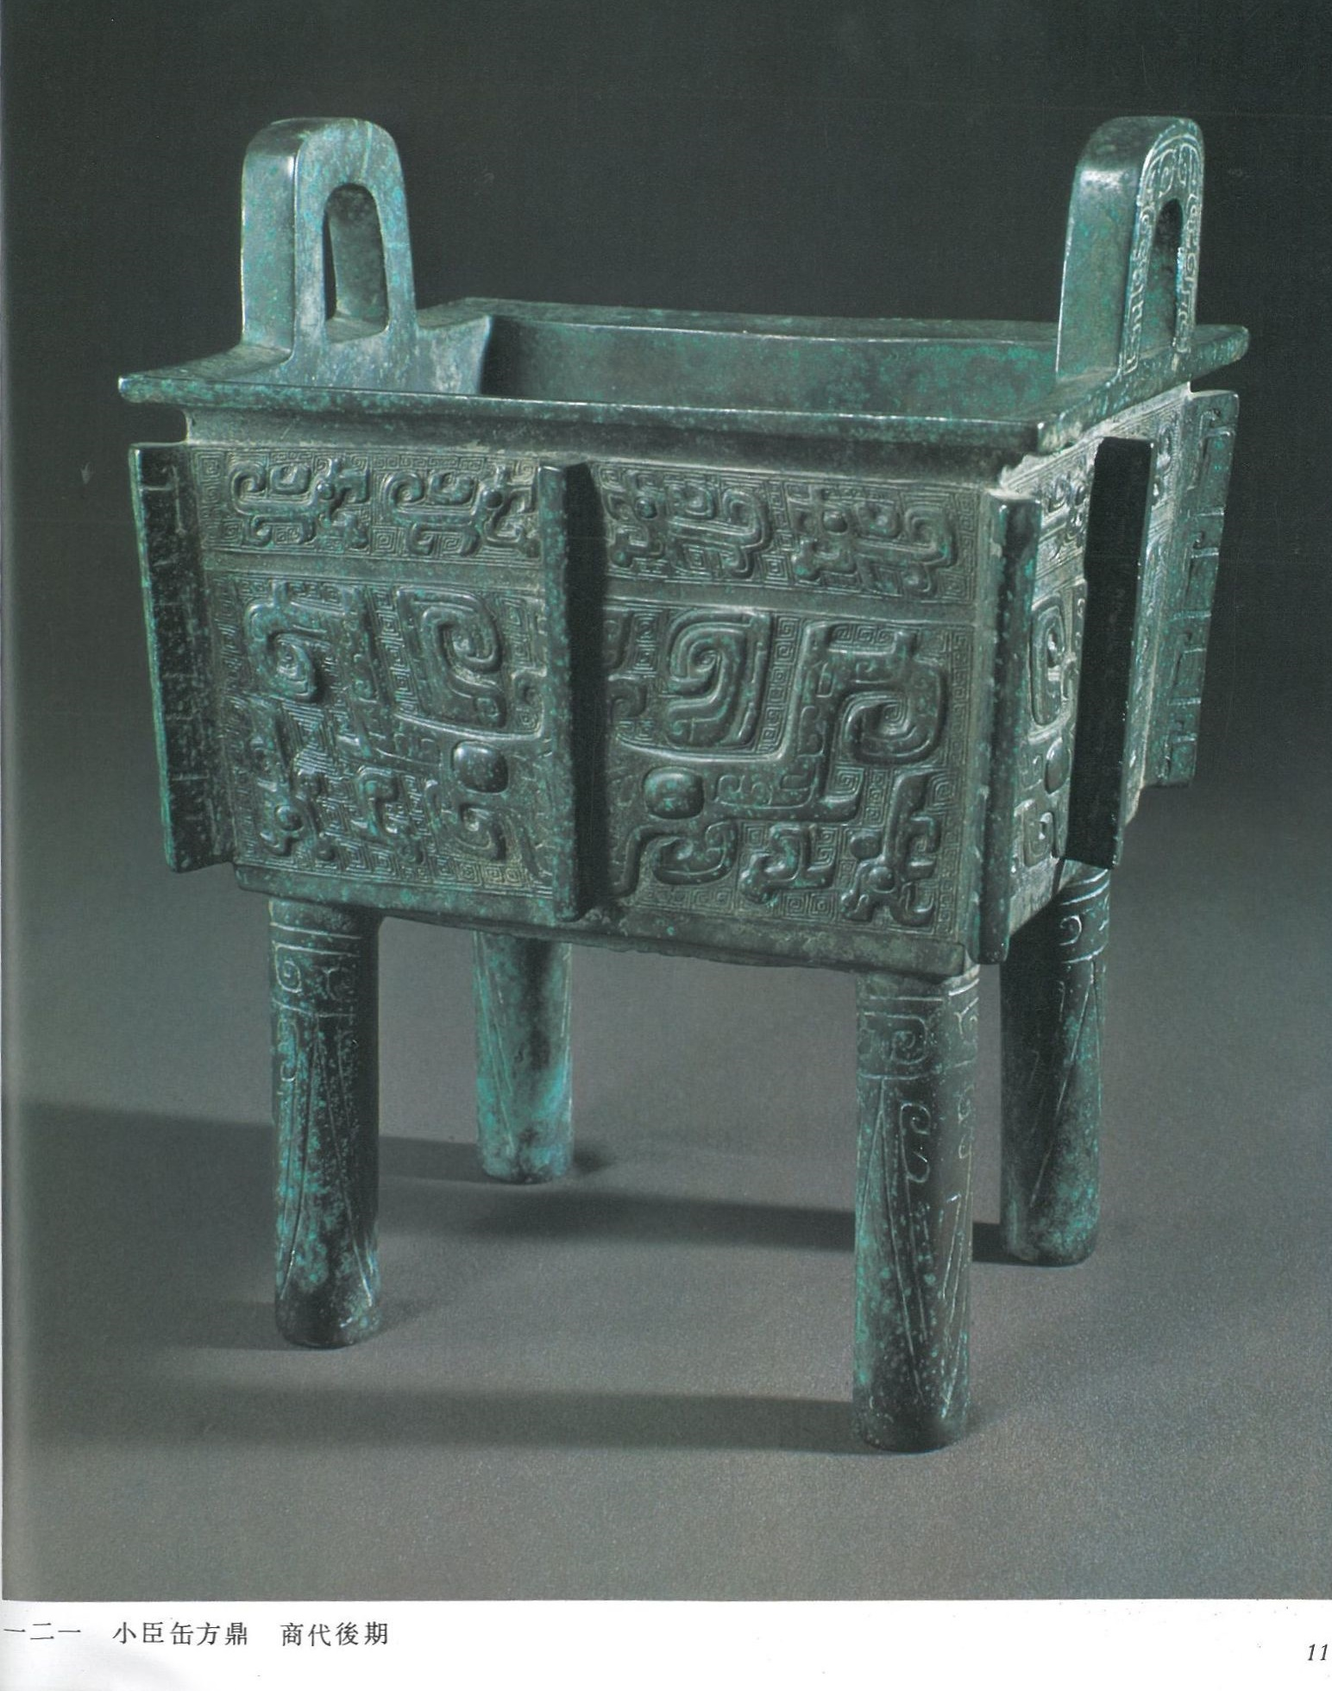
Taotie
Who: Workers
What: Bronze vessels
Where/when: During Shang dynasty china not specifically stated
Why:Seen as a monstrous mask that was protective and symbolic representation of nature forces.
Qualities: Has balance. Green Color repetitive patterns.

Slide 5
Han dynasty (206 BCE–220 CE)
Characterized by representing everyday life and stories from history and mythology.
Calligraphy could be used in engraved surfaces such as bronze and stone
They used animal hair brushes and ink that was mixed of compressed pine carbon and thinner glue.
Produced flamboyant characters and writing skills were essential to be taken serious.
Painting : Popularity of paintings was due to the accumulation of wealth
Portraits of the wealthy became common
Also early nature paintings

Slide 6
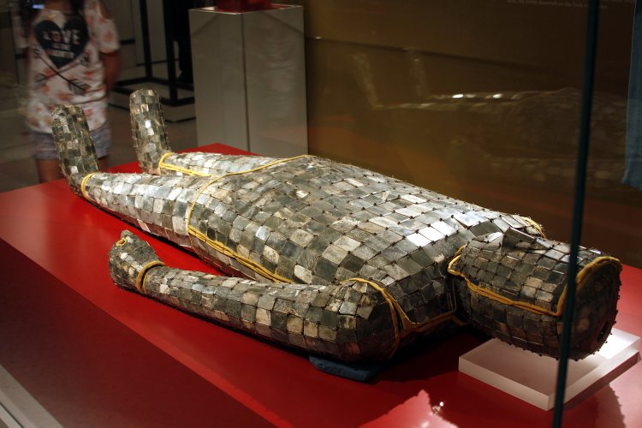
Han Jade Burial Site
Who: unknown
What: made from hundred of rectangle shapes of jade stitched together with gold and silver.
When/Where: Han dynasty (2nd century BCE - 2 century CE)
Why:Used to encase the body of deceased royalty
Artistic Qualities: Is a3d object that has repetitive pattern, texture must be hard.

Slide 7
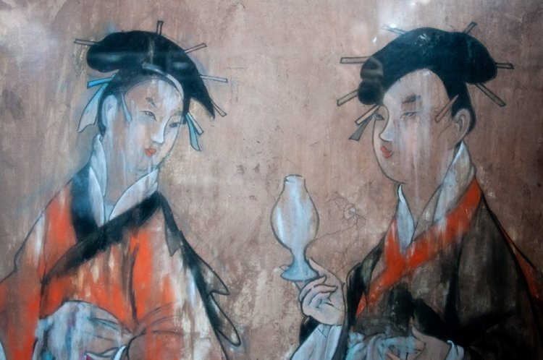
Han Women, Dahuting Tomb
Who:unknown
What:Ink tomb wall to paint on and brush
Where/When: two women. 25-220 CE. Zhengzhou, Henan province, China
Why: Portrait of the two women
What: Unity and has color shades of back and some vibrant colors.

Slide 8
Tang Dynasty (618-906 C.E)
During the reign of Emperor Xuanzong the classical period of arts began
New techniques a wider range of colors and a greater appreciation of art
Painting two objectives were to capture people and landscapes
Sculptures were mainly focus on Buddha
Many of the sculptures and paintings were destroyed during the persecution of Bufdjidts and monastariesbfuting the reign of Wuzkng of Tang ( 840-846 C.E)

Slide 9
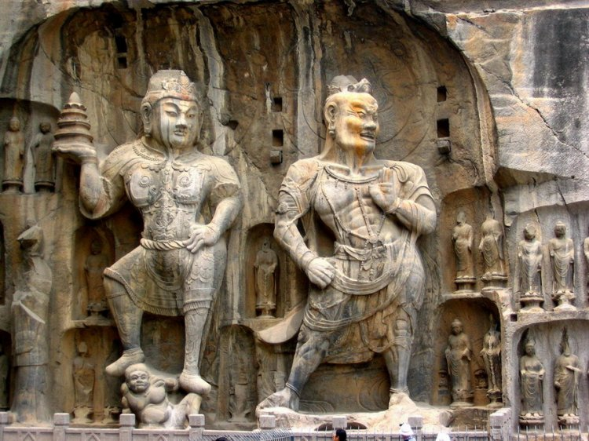
Buddhists sculptures longmen caves.
Who:unknown
Materials: stone
Where: Fengxian temple near Fengxian China
When: 675CE 17.4 meters tall
Why: Represents a Buddhist heavenly king and demon guardian
Qualities: It is a sculpture that emphasizes the two people as well as unity.

Slide 10
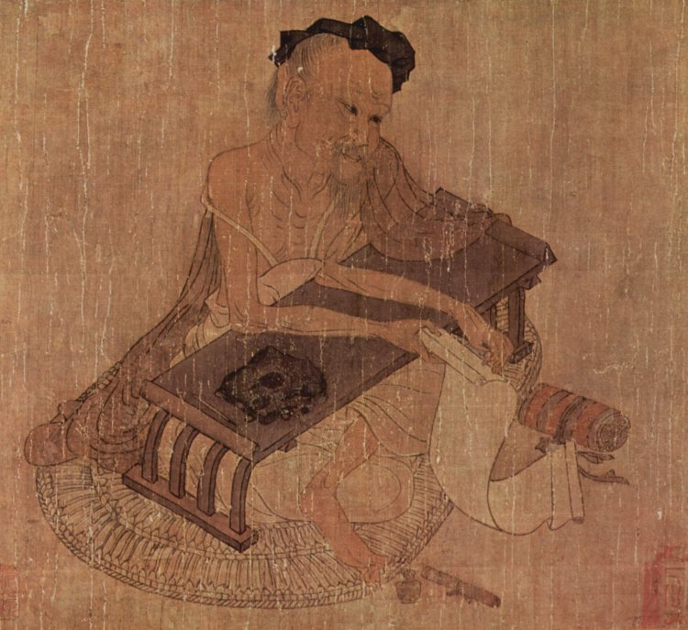
Fu sheng
Who; Wang wei (portrait painter and Poet)
What:
When/where An 8th century CE portrait of the 3rd-2nd century BCE Confucian scholar Fu Sheng,Osaka city Museum of fine arts , Japan.
Why:Many artworks were revolved around religion and making portraits.
What: Jagged edges shown as texture. Emphasizing in what he is doing rather than how he looks.

