Slide 1
Baroque
1600-1750
By Kevin Aranda

Slide 2
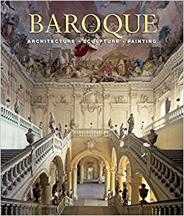
What is baroque?
1590-1720
embraced painting,sculptures, and architecture
characterized by drama, rich, deep colour, and intense light and dark shadows
encouraged by the Catholic Church, which decided that the arts should communicate religious themes and direct emotional involvement in response to the Protestant Reformation
Protestant Reformation was a major 16th century European movement aimed initially at reforming the beliefs and practices of the Roman Catholic Church.

Slide 3
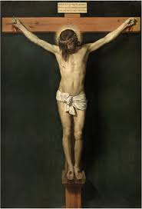
Christ Crucified
Made by Diego Velázquez
1632
Painted oil on canvas
Measures 249 x 170 cm
Owned by the museo el Prado
Shows color, texture and value
The significance is that it shows Jesus dying for our sins and is trying to influence you to follow the Roman Catholic Church

Slide 4
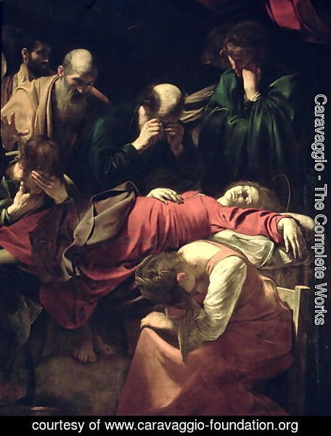
Death of the Virgin
Made by Caravaggio
1606
Oil on canvas
369 x 245 cm
Shows texture and value
The significance is the death of the Virgin Mary and conveys to the religious value that this painting has. It was sold to Charles I of England in 1627

Slide 5
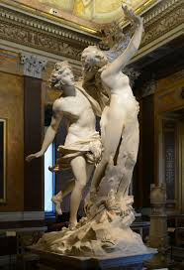
Apollo and Daphne
Made by Gian Lorenzo Bernini
1622-1625
Made of marble
243 cm height
Shows details and texture
the work depicts the climax of the story of Daphne and Phoebus in Ovid's Metamorphoses.

Slide 6
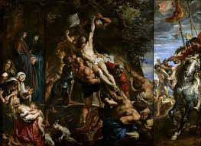
The Elevation of the Cross
Made by Peter Paul Rubens
1610
Oil on canvas
Located in the Cathedral of Our Lady
Shows harmony and emphasis
The significance is an important religious event in the Bible

Slide 7
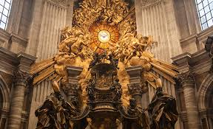
Chair of Saint Peter
Made by Gian Lorenzo Bernini
Created in 1666
Sculpture made out of Gilt Bronze
Located at Saint Peter’s Basilica, Vatican City
Shows emphasis and value
The significance is that is a relic from the Catholic religion

Slide 8
Thank You

